Slide 1



Home
Video
Profile
devhub.com
DevHub
A Simplified version of GitHub
CSE412 (Software Engineering)
Section: 04

Slide 2


Home
Video
Profile
Submitted By:
Syeda Tasmiah Chowdhury Orpa(2021-3-60-185)
Sagor Ahmed (2021-3-60-117)
Lamia Akter (2021-3-60-147)
Antara Labiba (2021-3-60-173)
Barsha Roy (2021-3-60-133)
Submitted To:
Nishat Tasnim Niloy
Lecturer,
Department of Computer Science and Engineering
East West University

Slide 3

Introduction
Purpose of the Project
To develop a simplified version of GitHub.
Designed for individual developers, students, and small teams who need basic repository management without the complexity of full GitHub.
Core Objectives
Offer a user-friendly, web-based platform for creating, managing, and sharing code repositories.
Support basic features such as pull requests, and issue tracking.
Design Philosophy
Focus on simplicity, usability, and scalability.
Prioritize essential features while leaving out advanced GitHub enterprise tools.

Slide 4


Features
User Authentication
Repository Creation
Repository Management
Add Files
Update Files
Delete Files
Commit History
Branch Management
Pull Requests
Issue Tracking
Collaborator Management
Forking Repositories
Stars and Ratings
Basic Notifications
Search Functionality

Slide 5

Non-Functional Properties
Scalability
Security
Usability
Reliability
Performance
Maintainability
Interoperability
Extensibility
Portability
Backup and Recovery

Slide 6


Languages

Slide 7

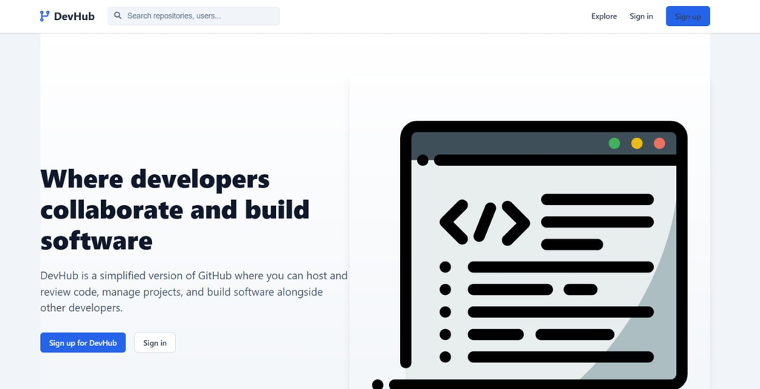
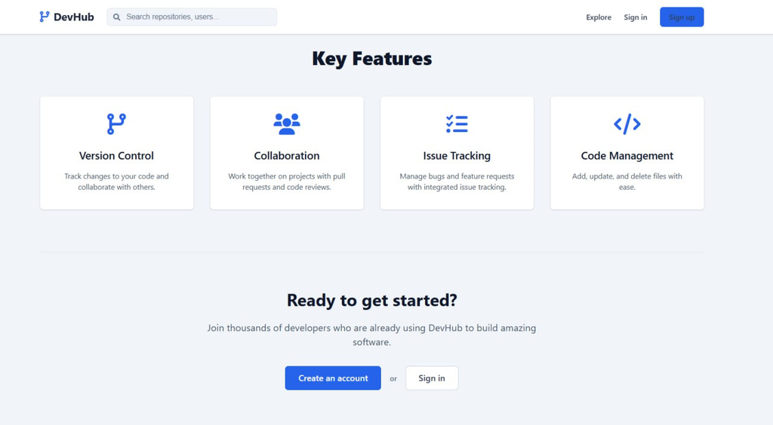
Featured Pages
Landing Page

Slide 8
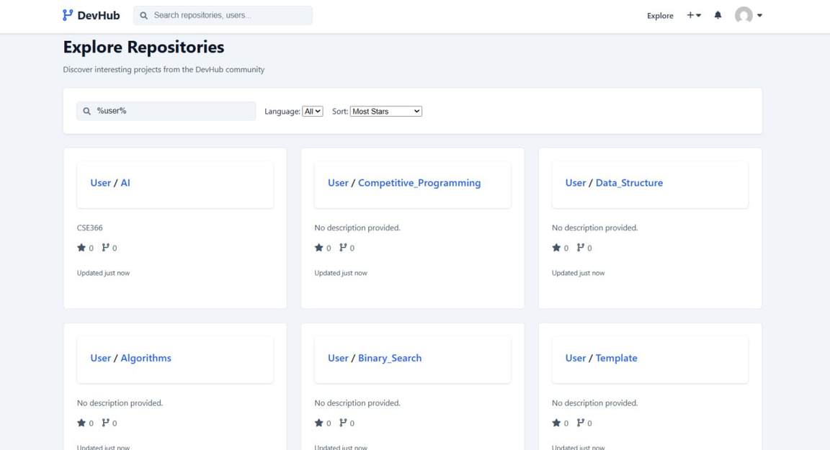
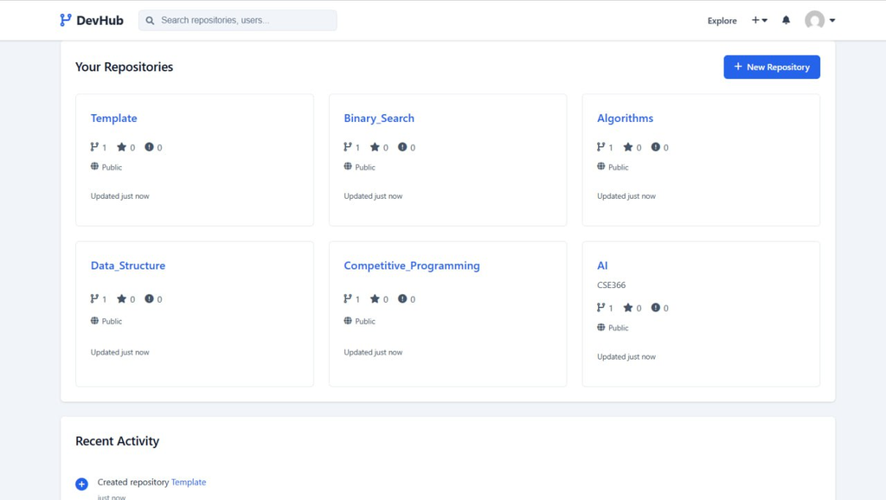
Featured Pages
Explore Repositories & Your Repositories

Slide 9
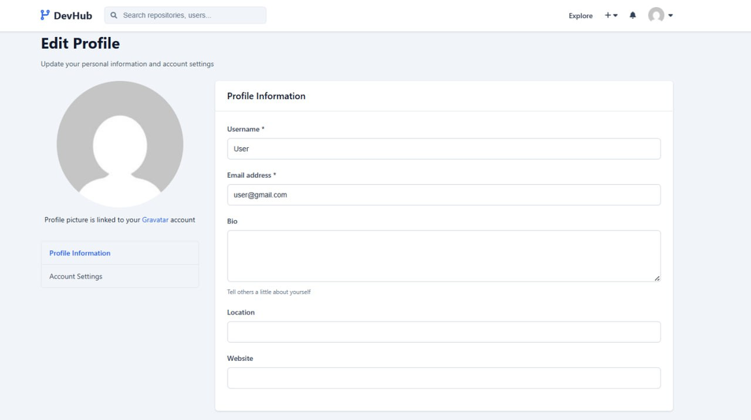
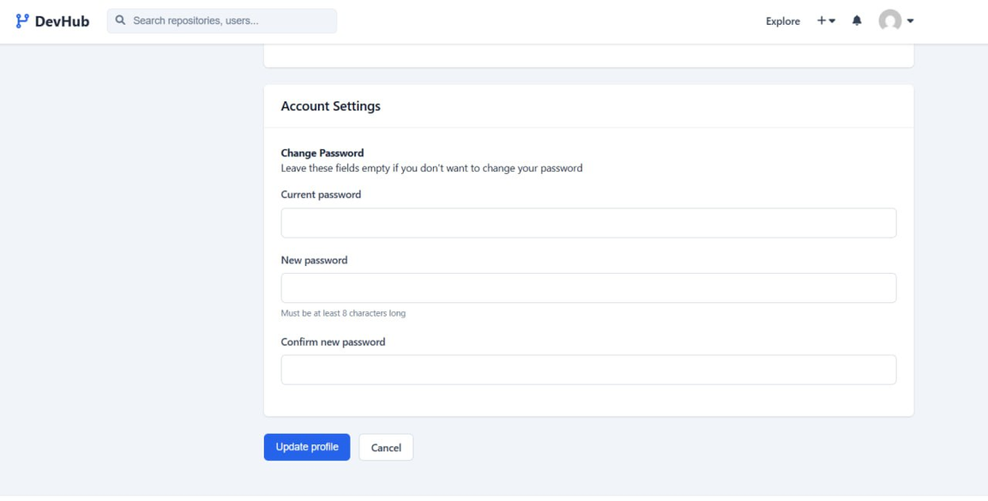
Featured Pages
Edit Profile & Password

Slide 10
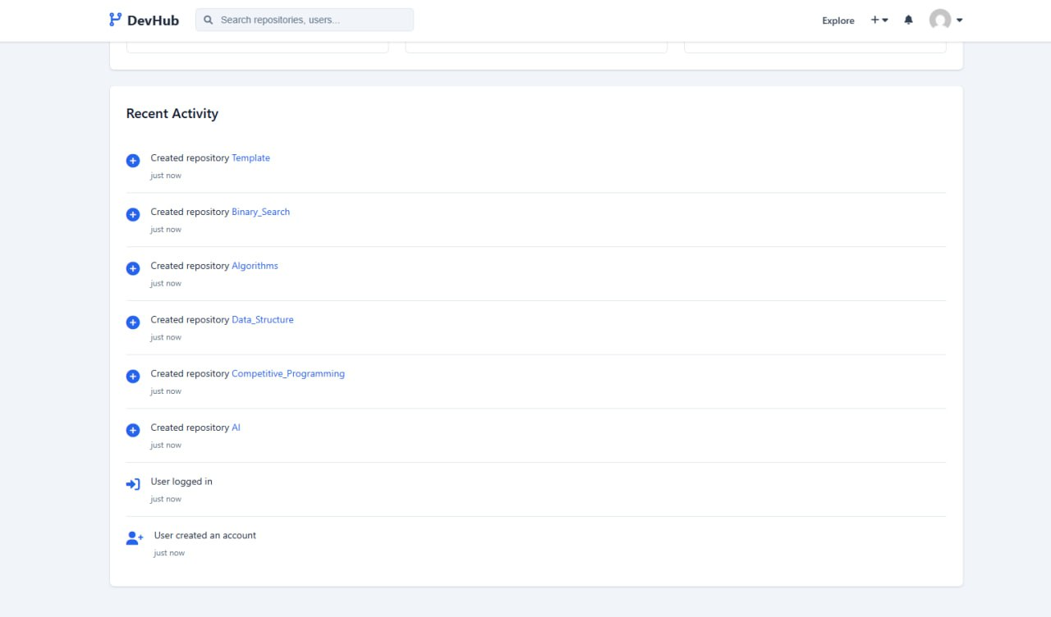
Featured Pages
See Recent Activity

Slide 11


Thank You

